Slide 1
Google Cloud Digital Leader
How anyone can get certified in 2 months

Slide 2
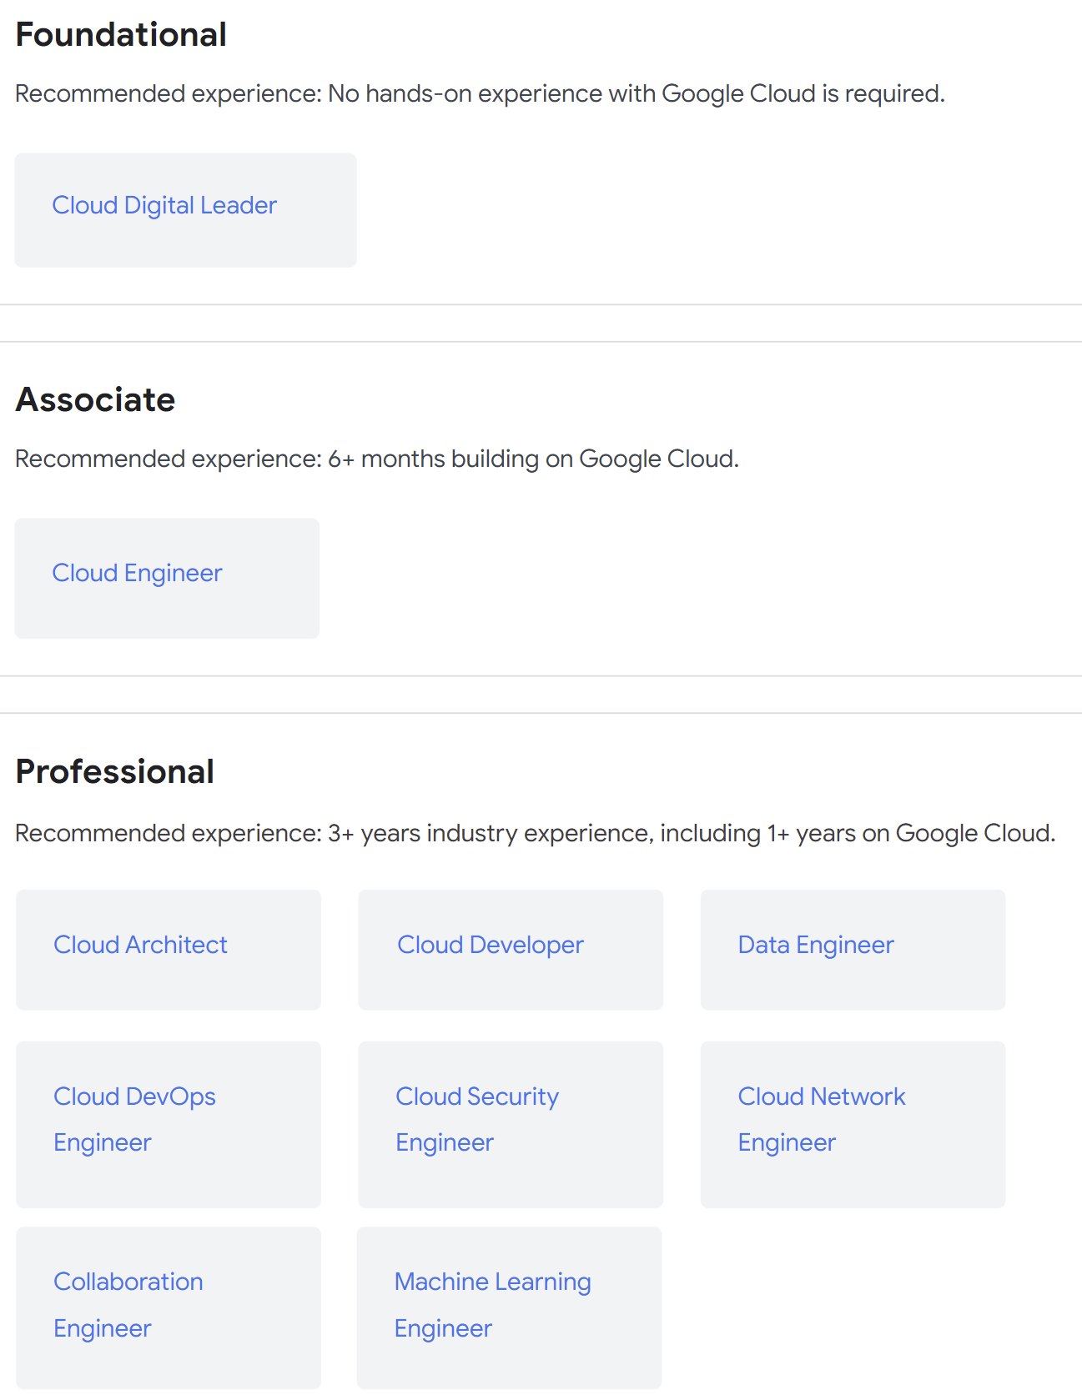
About the Exam
Length: 90 minutes, 50 questions, Pass/Fail
Registration fee: $99
Exam format: Multiple choice and multiple select
Exam delivery: Online Proctored or Test Center

Slide 3
Scheduling
GBS Multicloud Enablement Overview of Process
Learning Request Tool Manager Approval
Google Webassessor Account Use IBM email
Exam Registration AMEX Card
Concur Expense Report

Slide 4
Review
About 2 months of studying
Consistent eyes on content
Most questions scenario based
Be able to tell apart services
Not much console commands
Expensing for Google services
Hierarchy of projects and IAM

Slide 5
Resources
YL: Become a Google Cloud Digital Leader
YouTube: Google Cloud Digital Leader
Official Google Practice Exam
Official Google Practice Exam 2022
Google Cloud Documentation
GCP Review Folder: Box Link
Slack Channel: #googlecloud-gcp
Associate Cloud Engineer Book

Slide 6
How I Passed with no prior experience in Google Cloud
Understand why people paying for service?
Udemy Course and YouTube Playlist
Take Practice Exam
Review incorrect – and why you can eliminate choices
Udemy Course Skim Again
Take Practice Exam Again
Exam week: Visual Sketchnotes

